Slide 1
Python Built-in Exceptions
DVT101 – Lecture 43
- By Dataverse Tutorials

Slide 2
What are Built-in Exceptions in Python?
Meaning of exceptions in Python
Runtime error signaling mechanism
Why built-in exceptions exist
Role in debugging and stability

Slide 3
Why Understanding Built-in Exceptions Matters
Faster debugging
Predictable error handling
Writing defensive code
Production-ready applications

Slide 4
Python Exception Hierarchy
Root of exception hierarchy
Parent–child relationship
Why hierarchy matters
Generic vs specific handling

Slide 5
BaseException
Base class of all exceptions
Rarely used directly
Foundation of error system
Why Python needs a root class

Slide 6
Exception Class
Parent of most runtime exceptions
Generic exception handling
When to catch Exception
Difference from BaseException

Slide 7
ArithmeticError Family
Purpose of arithmetic-related errors
Common subclasses
Group handling of math issues
When arithmetic errors occur

Slide 8
ZeroDivisionError
Meaning of division by zero
Mathematical invalid operation
Common beginner mistake
Safe handling strategy

Slide 9
OverflowError
Extremely large numeric results
Floating-point limitations
When overflow happens
Scientific and ML relevance

Slide 10
FloatingPointError
Floating-point computation failures
Silent vs explicit error handling
Library-controlled behavior
Numerical stability concerns

Slide 11
AssertionError
Purpose of assertions
Debugging assumptions
Testing and validation usage
Why assertions fail

Slide 12
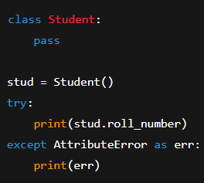
AttributeError
Missing attributes in objects
Object-oriented misuse
Common class-related mistake
Safe attribute access mindset

Slide 13
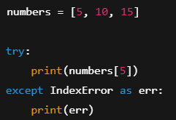
IndexError
Sequence boundary violations
List and tuple access issues
Loop-related mistakes
Defensive indexing

Slide 14
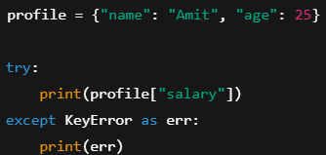
KeyError
Dictionary key lookup failures
Difference from IndexError
Safe dictionary access patterns
Real-world data issues

Slide 15
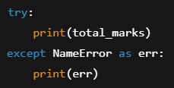
NameError
Undefined variables or functions
Scope-related mistakes
Typographical errors
Namespace awareness

Slide 16
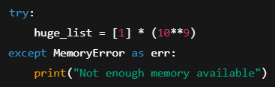

MemoryError
Memory allocation failure
Large data structure risks
System resource limits
Big data caution

Slide 17
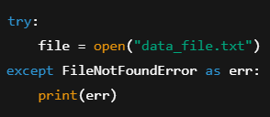
OSError and File-related Exceptions
Operating system interaction failures
File and directory issues
FileNotFoundError relationship
Robust file handling mindset

Slide 18
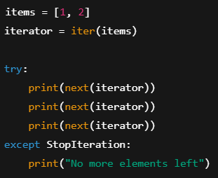
StopIteration
Iterator exhaustion signal
Loop termination mechanism
Internal role in for-loops
Iterator protocol connection

Slide 19

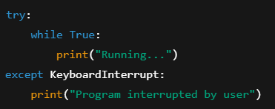
System-level Exceptions
KeyboardInterrupt meaning
SystemExit usage
Program termination signals
Controlled shutdown logic

Slide 20
Other Common Built-in Exceptions
TypeError vs ValueError
ImportError and ModuleNotFoundError
RuntimeError overview
RecursionError meaning

Slide 21
Summary & Key Takeaways
Importance of knowing exceptions
Specific vs generic handling
Writing safer Python code
Debugging confidence boost

Slide 22


